Slide 1
Mobile App Development
Lecture 02

Slide 2
Basic fundamentals
If-else
Nested if-else
String operations
Loop

Slide 3
If-else
if(boolean_expression){
// statement(s) will execute if the Boolean expression is true.
}
else {
// statement(s) will execute if the Boolean expression is false.
}

Slide 4
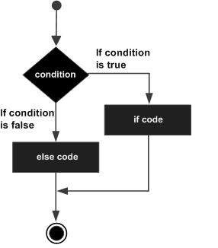
Working of If-else

Slide 5
Even Odd program using if-else
void main() {
var num = 12;
if (num % 2==0) {
print("Even");
}
else
{
print("Odd");
}
}

Slide 6
If – else if – else
if (boolean_expression1) {
//statements if the expression1 evaluates to true
}
else if (boolean_expression2) {
//statements if the expression2 evaluates to true
}
else {
//statements if both expression1 and expression2 result to false
}

Slide 7
If – else if – else
void main() {
var num = 2;
if(num > 0) {
print("${num} is positive");
}
else if(num < 0) {
print("${num} is negative");
}
else {
print("${num} is neither positive nor negative");
}
}

Slide 8
Nested if-else
if ( condition1 )
{
if ( condition2 ){
// Body of if
}
else {
// Body of else
}
}

Slide 9
Nested If-else
void main()
{
int gfg = 10;
if (gfg > 9) {
gfg++;
if (gfg < 10) {
print("Condition 2 is true");
}
else {
print("All the conditions are false");
}
}
}

Slide 10
String Operations
1 | toLowerCase()Converts all characters in this string to lower case.
2 | toUpperCase()Converts all characters in this string to upper case.
3 | trim()Returns the string without any leading and trailing whitespace.
4 | compareTo()Compares this object to another.
5 | replaceAll()Replaces all substrings that match the specified pattern with a given value.
6 | split()Splits the string at matches of the specified delimiter and returns a list of substrings.
7 | substring()Returns the substring of this string that extends from startIndex, inclusive, to endIndex, exclusive.
8 | toString()Returns a string representation of this object.
9 | codeUnitAt()Returns the 16-bit UTF-16 code unit at the given index.

Slide 11
Loops
For loop
While loop
Do-while loop
Extended for loop

Slide 12
For loop
for (initial_count_value; termination-condition; step) {
//statements
}

Slide 13
For loop
for (int i=0; i<10;i++) {
print(i);
}

Slide 14
While loop
while(termination-condition) {
//statements
}

Slide 15
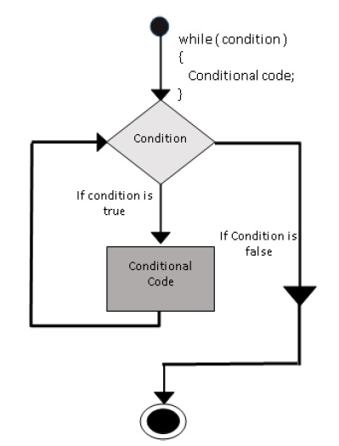
While loop

Slide 16
While loop
int i=0;
while (i<10) {
print(i);
i++;
}

Slide 17
do-while loop
do{
//statements
} while(termination-condition);

Slide 18
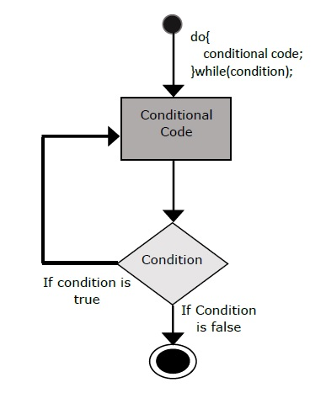
do-while loop

Slide 19
do-while loop
void main()
{
var n = 10;
do {
print(n);
n--;
} while(n>=0);
}

Slide 20
Extended for loop
for (variablename in object)
{
statement or block to execute
}

Slide 21
Extended for loop
void main() {
var obj = [12,13,14];
for (var prop in obj) {
print(prop);
}
}

